Slide 1

CPSC 319 Data Structures, Algorithms, and Their Applications Winter 2024

Slide 2
Introduction
Nima Vahidi Ferdowsi
MSc student under the supervision of Dr. Mario Costa Sousa and Dr. Usman Alim
Deep Neural Networks for Style Transfer in Computer Graphics and Visualization
Email: nima.vahidiferdowsi@ucalgary.ca
Please start your subject with "CPSC 319 - "

Slide 3
Outline
Java Primer (Chapter 1)
Fundamental Data Structures (Chapter 3)
Specifics about the Programming Assignments
Any specific data structures/algorithms covered in class throughout the term

Slide 4
Recursion
A programming concept where a function calls itself to solve a problem.
Continues until a base case is reached, returning a result without further recursive calls.
Factorial:
n! = n × (n-1) × … × 2 × 1

Slide 5
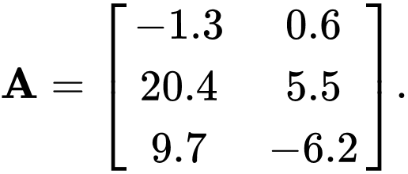
Matrix
A matrix is a two-dimensional array of numbers, symbols, or expressions arranged in rows and columns.
Denoted by an uppercase letter, such as A.
Matrix Elements: a_{ij} represents the element in the i-th row and j-th column of matrix A.
Matrix Size: m×n indicates a matrix with m rows and n columns.

Slide 6
Matrix Operations
Addition:
C = A + B for matrices A, B, and C of the same size.
c_{ij} = a_{ij} - b_{ij}
Subtraction:
C = A - B for matrices A, B, and C of the same size.
c_{ij} = a_{ij} - b_{ij}
Scalar Multiplication:
C = k ⋅ A for a scalar k and matrix A.
c_{ij} = k ⋅ a_{ij}
Matrix Multiplication:
C = A × B for matrices A, B, and C with appropriate dimensions.
c_{ij} = ∑_{k=1}^{n} a_{ik} ⋅ b_{kj}
Transpose:
B = A^{T} where B is the transpose of A.
b_{ij} = a_{ji}

Slide 7
Exponentiation
Exponentiation is the process of raising a number (base) to a certain power (exponent).
n^{m} = n × n^{m-1}
n^{m} = n^{m/2} × n^{m/2} × n (m is odd)
n^{m} = n^{m/2} × n^{m/2} (m is even)

